Slide 1
Group:102
Rate My Course
A Platform that offer a detailed course review and some more information
Bowen
Phaneendra
Srikar
Yifang Feng
Yifang Wang
Wenjing

Slide 2
02
Timeline
Software Requirement
& Design
Ideation
Delivery
Apr.10
Apr.19
May.1
Testing
Apr.4
May.18
May.30
Project
Requirements
Team Formation
May.22
May.27
Development
Deployment

Slide 3

03
Ideation
Drawbacks of Existing Platform
Pros of Rate My Course:
Fragmented Information: Data scattered across multiple platforms like RateMyProfessor, Reddit, Discord.
Focused and Comprehensive: Designed by SCU students for SCU students, providing detailed and organized information about courses, lecturers and course materials (syllabus).
Unverified Reviews: No mechanism to validate if reviews are from actual university students.
Easy to use filter: focused on courses and professors with simple filter to find course of interest.
Inadequate Information: Lack of data on new lecturers and specific course details.
Verified Reviewers: Implementing a verification mechanism for accounts to enhance reliability and credibility.
Time Consuming: Navigating and searching for information on various platforms is tedious.
Practical Benefits: The platform aims to save students time, money and help with academic success at SCU.

Slide 4
04
Requirements
Functional Requirements
Non-Functional Requirements
1. Users can login or signup to application only through their SCU email ID.
2. Users find reviews based on the filter selection of the department and course.
3. Users should be able to see list of reviews of all courses available at SCU and all reviews are grouped by professor teaching the course.
4. Users should be able to rate the course on a scale of 1 to 10, give review of the course, select the difficulty of the course and the grade they achieved.
5. The same user cannot submit multiple reviews, however can edit their previous review.
1.Should maintain user sessions for at least 24 hours.
2.An average rating is to be calculated for the group of reviews of each associated professor.
3.Users should be able to download a syllabus copy, which is uploaded by the maintenance team after acquiring it from a reliable source

Slide 5
05
Part
Design

Slide 6
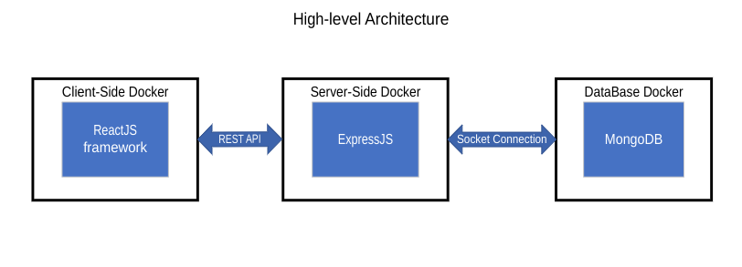
06
Architecture Design
Notes:
https://pixabay.comzh男子-阅读-触摸屏-博客-数字-片剂-工作-娱乐休闲-屏幕-791049

Slide 7
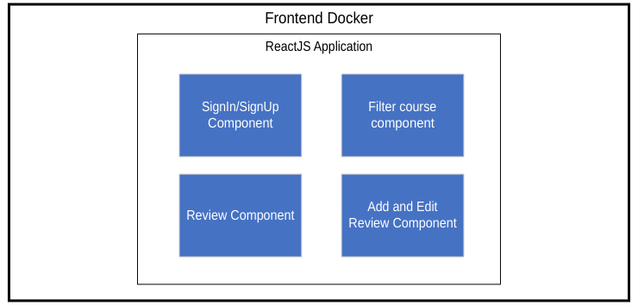
07
Component Design
Notes:
https://pixabay.comzh男子-阅读-触摸屏-博客-数字-片剂-工作-娱乐休闲-屏幕-791049

Slide 8
08
DataBase Design
User Collection Schema
U
Email: String
Data_Created: DateObject
Hash_Password: String
Course Collection Schema
C
Dept:String
Course_code:String
Course_name:String
Department Collection Schema
D
Dept_code:String
Dept_name:String
Reviews[1]
0{5}
Review:String
Rating:Float
ReviewerID:String
Difficulty:String
Grade: String
Review Collection Schema
R
CourseName:String
Credits: String
Instructor: String
RatingAvg: Float
Syllabus{3}
Data:String
filename: string
filetype: stirng

Slide 9
09
Part
Functional
Specification

Slide 10
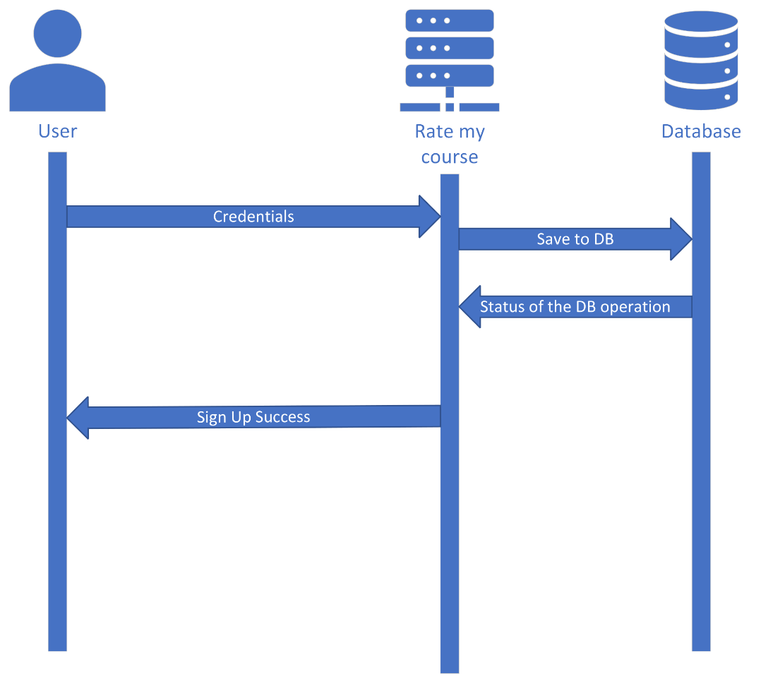
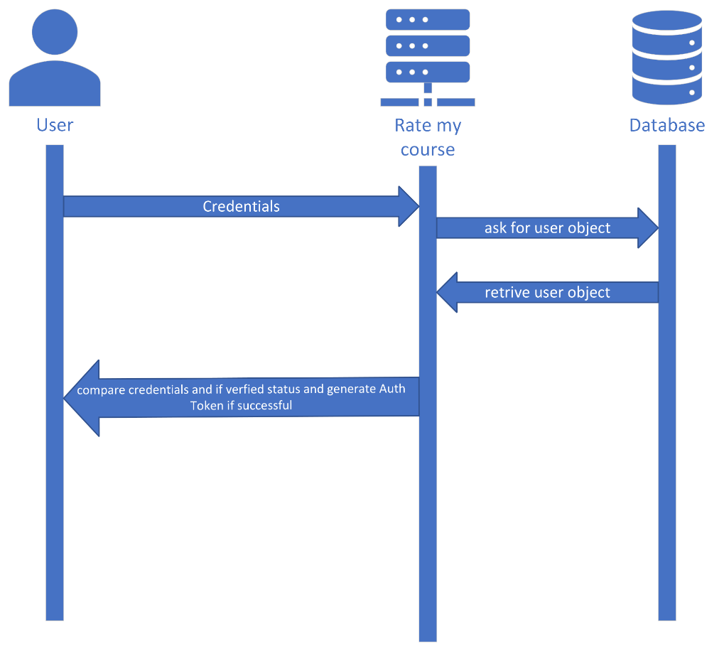
Sequence Diagrams
10
Sign Up
Sign In
Notes:
https://pixabay.comzh男子-阅读-触摸屏-博客-数字-片剂-工作-娱乐休闲-屏幕-791049

Slide 11
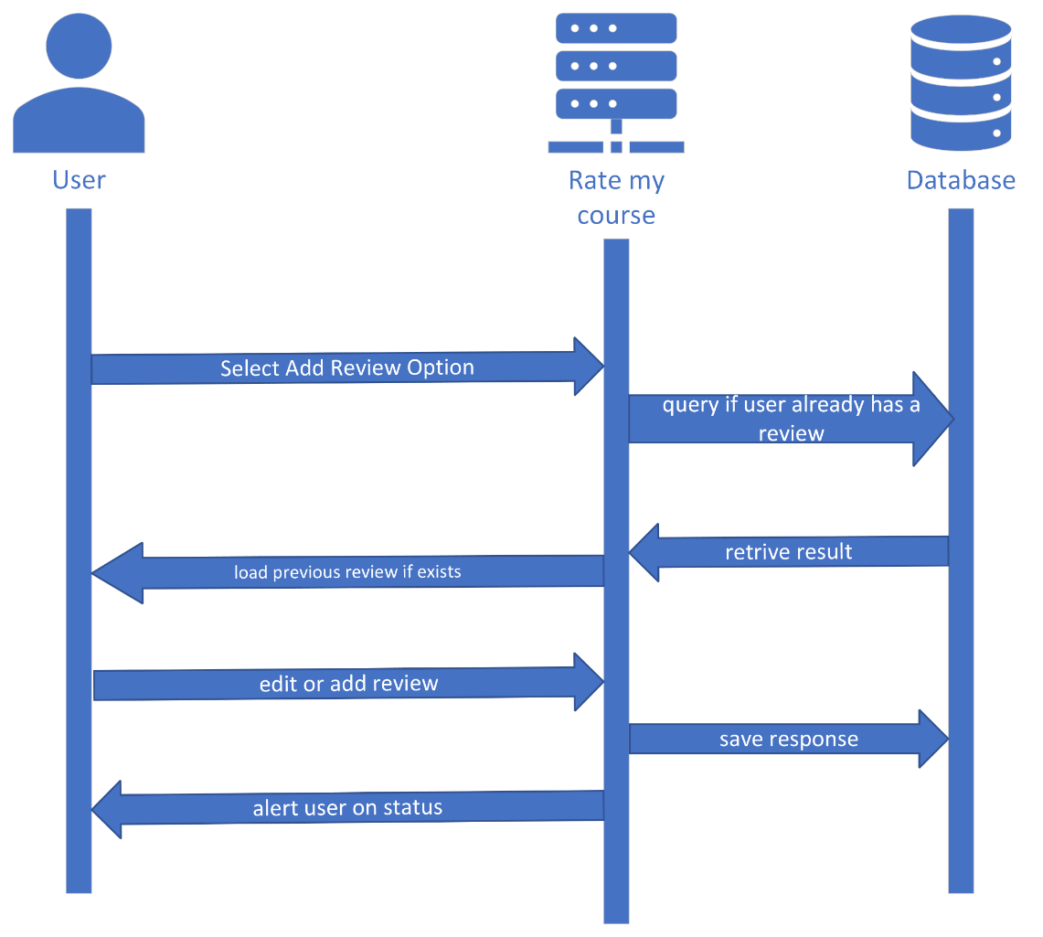
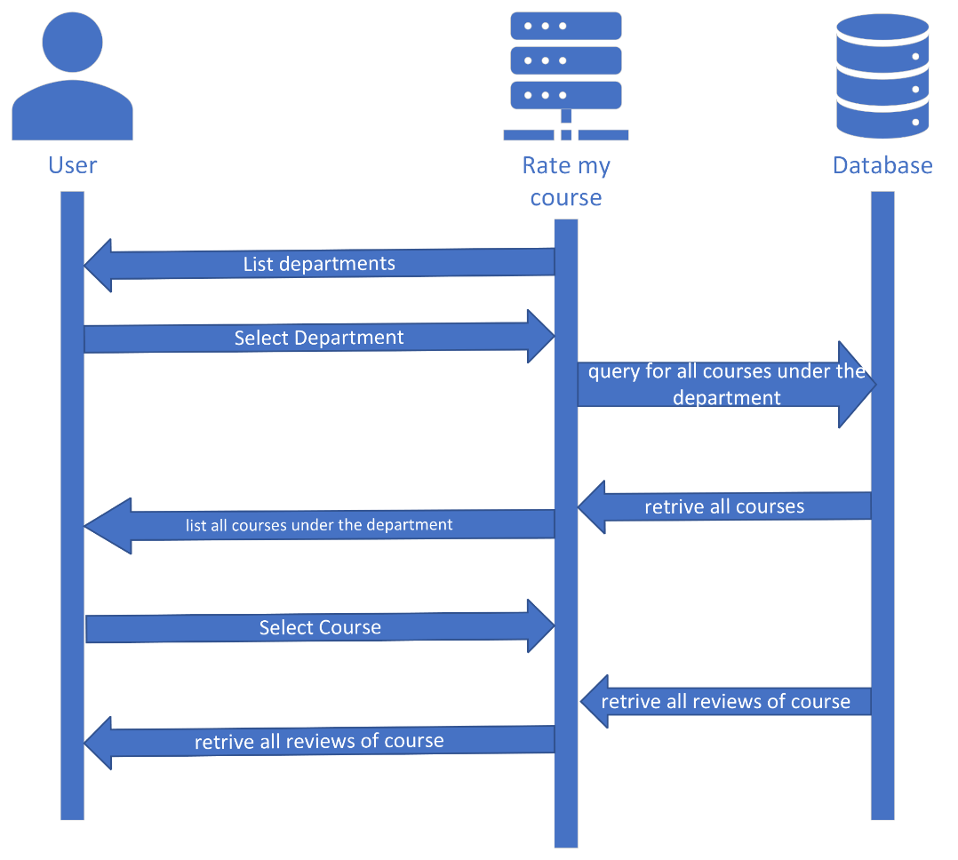
11
Filter
Add Review
Notes:
https://pixabay.comzh男子-阅读-触摸屏-博客-数字-片剂-工作-娱乐休闲-屏幕-791049

Slide 12
12
Functional Modules
Filter Module
User Module
Review Module
Department List
Course List By Department
Filter Reviews based on
Department and Course
Sign Up
Sign In
Verify User Email
Generate Session Key
Add Review
Check if reviewer by user exist
Edit Review

Slide 13
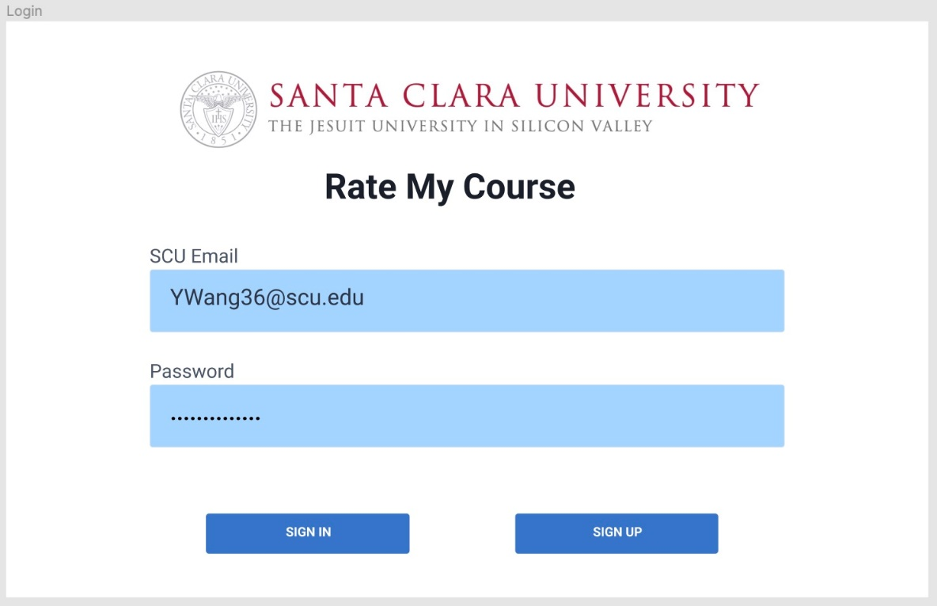
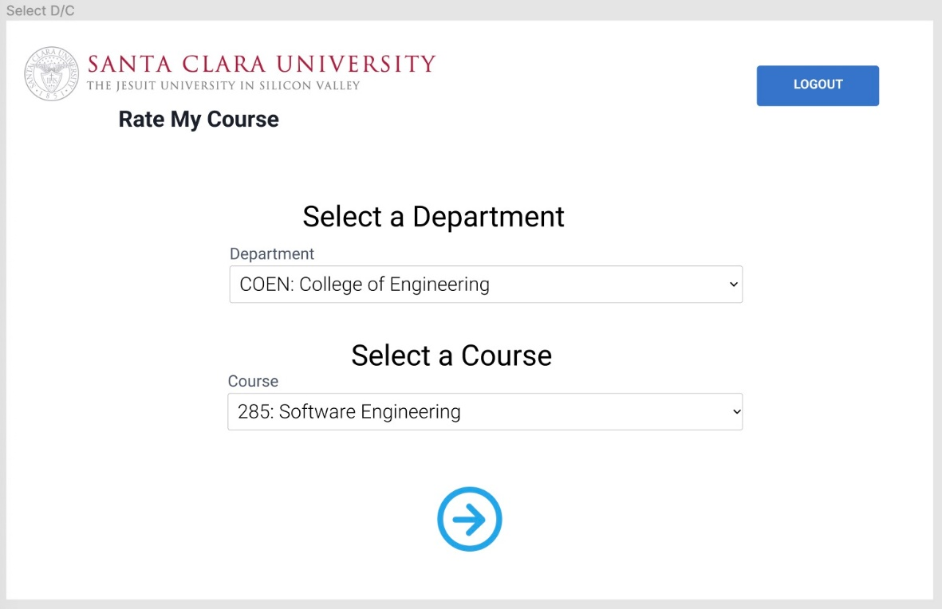
13
UI Design
Sign In/Up Page
Filter Page

Slide 14
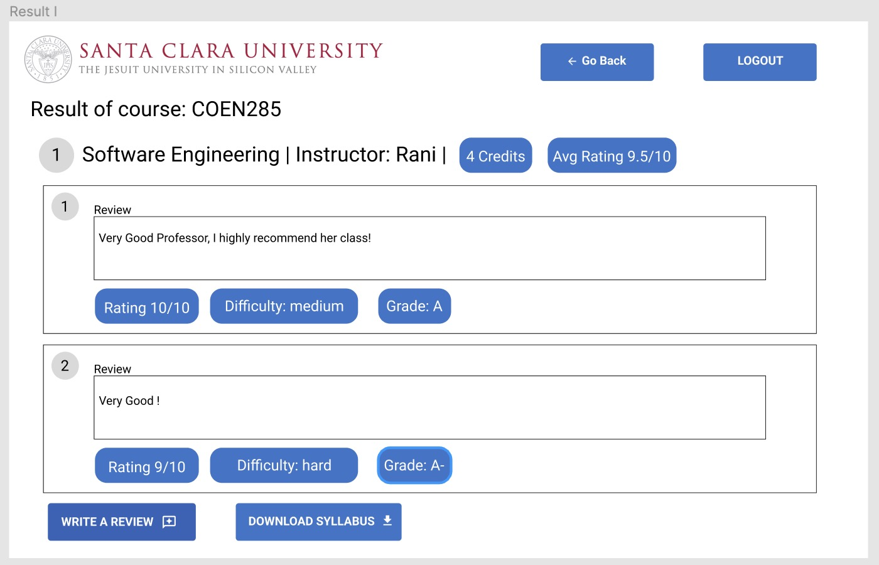
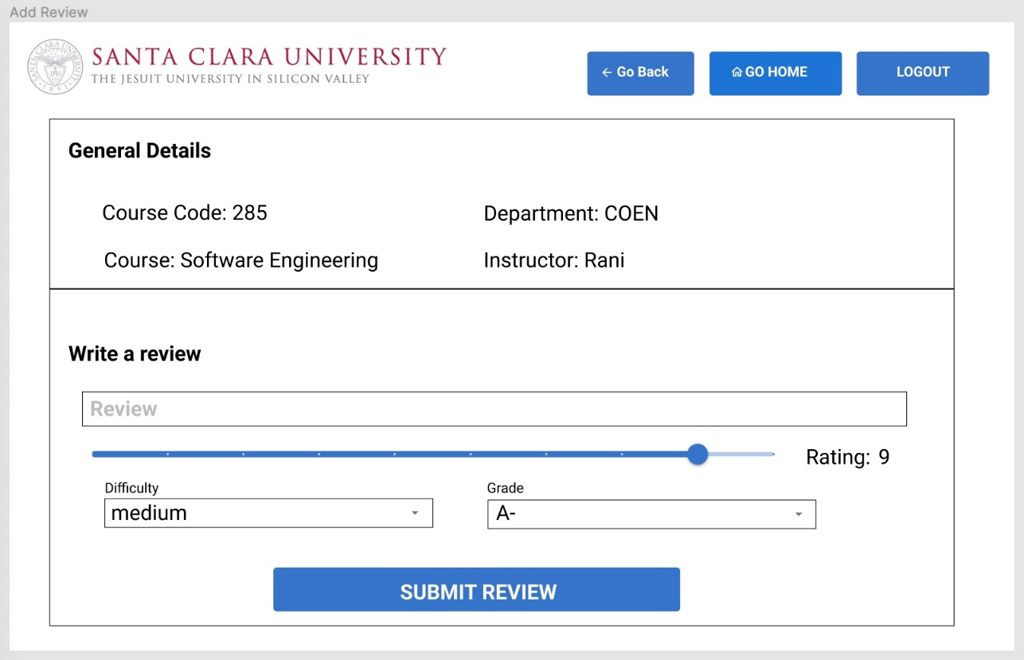
UI Design
14
Review List Page
Add Review Page
Notes:
https://pixabay.comzh男子-阅读-触摸屏-博客-数字-片剂-工作-娱乐休闲-屏幕-791049

Slide 15
15
Part
Development

Slide 16
17
Technologies Used for development
01.
02.
03.
React JS
Express JS
Mongo DB
frontend js framework
backend nodejs framework
Database

Slide 17
18
Tools Used
Tools
GitHub - Version Control
Figma - UI Design
JEST - generate code coverage report
MongoDB Compass - Visualize DB data
Docker - Container Deployment
Prometheus - Monitoring Containers
Grafana - Docker Metrics visualization
Postman - Rapid API Testing
Vite - Bundling React App
Tools
We
Use
Repository Link: https://github.com/Phaneendra97/SoftwareEngineering-102/tree/v1.1

Slide 18
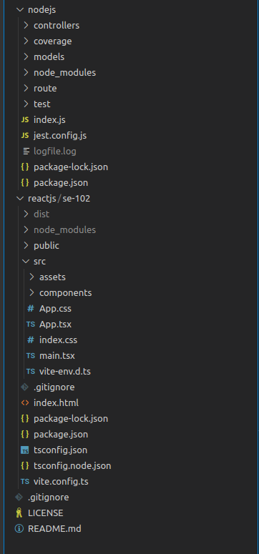
Project Structure
16
Front End server
Backend Server
Notes:
https://pixabay.comzh男子-阅读-触摸屏-博客-数字-片剂-工作-娱乐休闲-屏幕-791049

Slide 19
19
Part
Testing

Slide 20
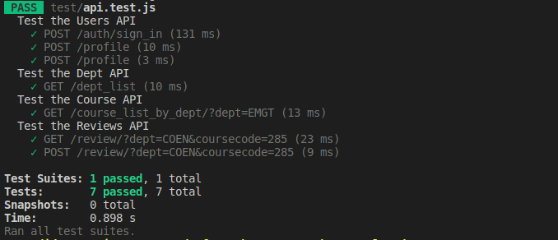
20
Unit Testing using JEST
Notes:
https://pixabay.comzh男子-阅读-触摸屏-博客-数字-片剂-工作-娱乐休闲-屏幕-791049

Slide 21
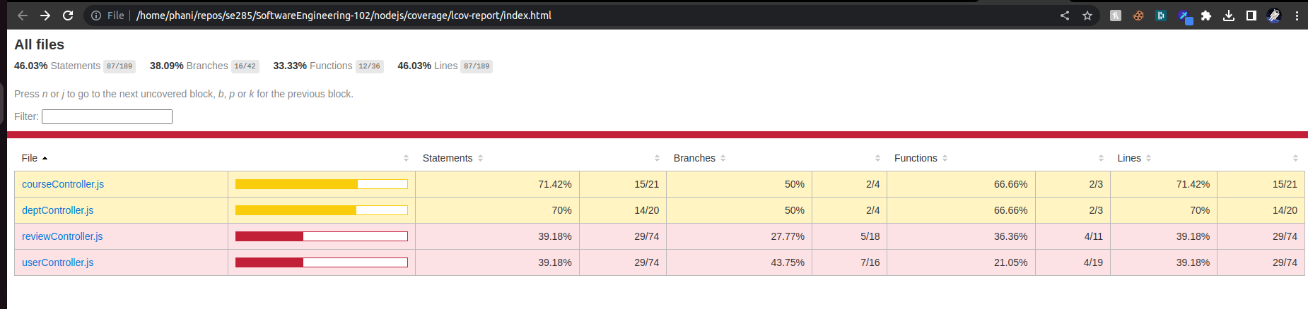
21
Unit Testing Coverage Report
Notes:
https://pixabay.comzh男子-阅读-触摸屏-博客-数字-片剂-工作-娱乐休闲-屏幕-791049

Slide 22
22
End to End Testing
18 Test Cases documented
Testing user interaction with Sign In/Up
Testing user interaction with Filter Page
Testing user interaction with Reviews Page
End to End testing

Slide 23
Performance Testing API’s
using POSTMAN Runner
23
API | End Point | Iterations | AVG
Sign-In (POST) | host:3000/auth/sign_in | 100 | 75ms
Profile (POST) | host:3000/profile | 100 | 6ms
Verify (GET) | host:80/auth/verify | 100 | 4ms
Dept List (GET) | host:3000/dept_list | 100 | 12ms
Health React (GET) | host:80/health.html | 100 | 5ms
Health Node (GET) | host:3000/health | 100 | 5ms
Course List by Dept (GET) | host:3000/course_list_by_dept/?dept=EMGT | 100 | 51ms
Reviews by Dept and Code (GET) | host:3000/review/?dept=COEN&coursecode=285 | 100 | 17ms
Check Review Exists (POST) | host:3000/check_review_exists/ | 100 | 10ms
Add Review (POST) | host:3000/add_review | 100 | 15ms
Notes:
https://pixabay.comzh男子-阅读-触摸屏-博客-数字-片剂-工作-娱乐休闲-屏幕-791049

Slide 24
24
Cross-Browser Compatibility Testing
Browsers we test
Chrome
Safari
FireFox
Microsoft Edge
Opera
Browser Testing

Slide 25
25
Bugs
Bugs Report after End to End Testing
3 cosmetic bugs reported and resolved with with T+1 turnaround time.
2 bugs in functionality reported and resolved with T+1 turnaround time.
Review text was hard to read if review size was too long - P3 - S3
Missing feedback on Sign In if credentials of the user was incorrect - P2 - S2
Message for “No syllabus copy present” was missing if syllabus copy was not attached to review - P2 - S4
Average Rating miscalculation fixed - P2 - S2
Verify Email not being sent to new users after sign up - P1 - S1

Slide 26
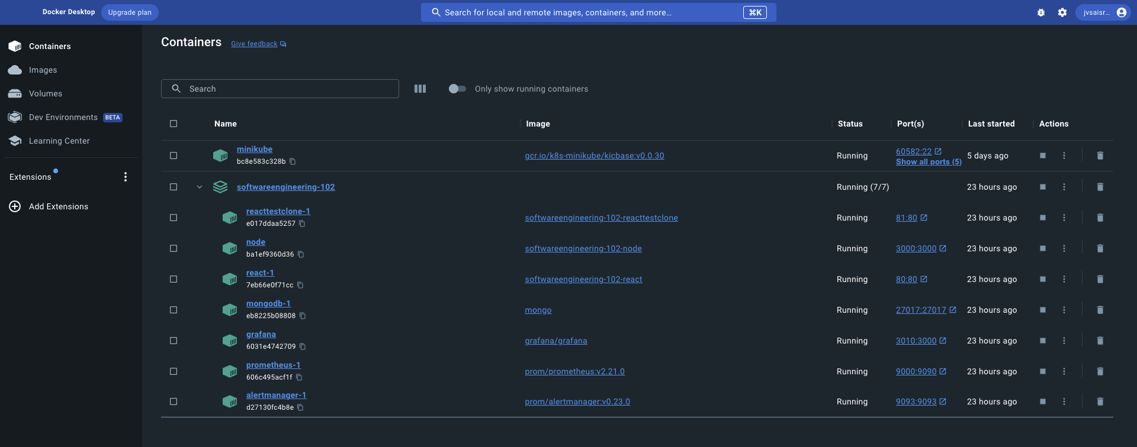
Deployment
26
Microservices deployed in Docker
Notes:
https://pixabay.comzh男子-阅读-触摸屏-博客-数字-片剂-工作-娱乐休闲-屏幕-791049

Slide 27
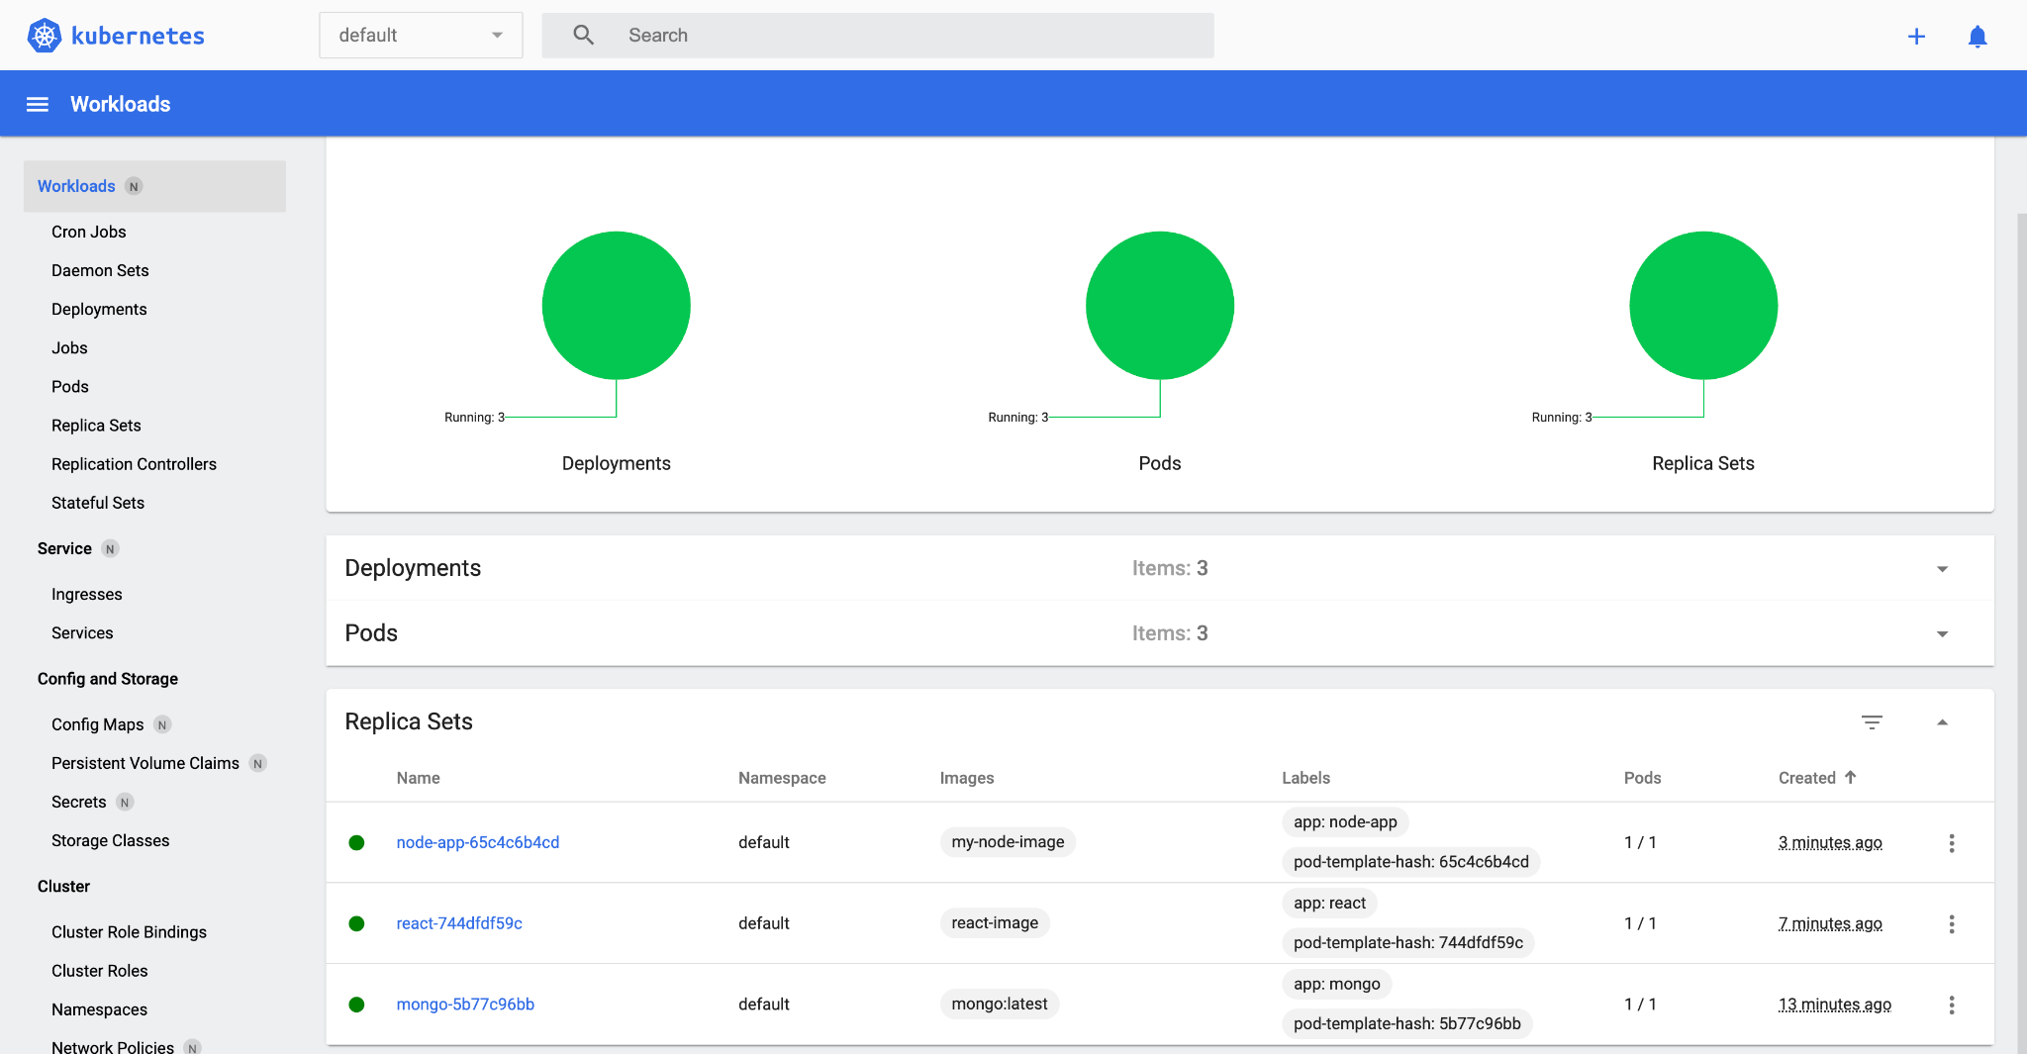
Deployment
27
Kubernetes in minikube for container orchestration(facing networking issue).
Notes:
https://pixabay.comzh男子-阅读-触摸屏-博客-数字-片剂-工作-娱乐休闲-屏幕-791049

Slide 28
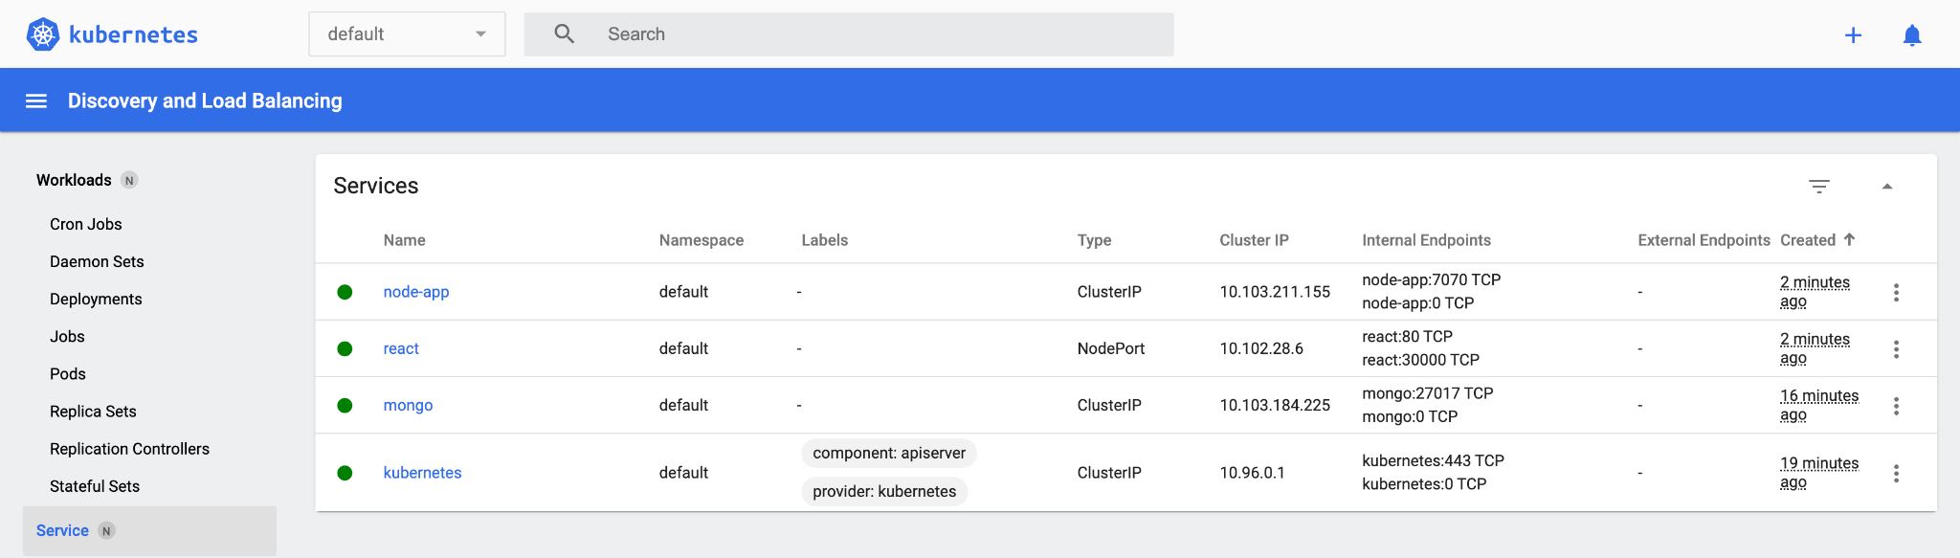
28
Deployment
Kubernetes Services.
Notes:
https://pixabay.comzh男子-阅读-触摸屏-博客-数字-片剂-工作-娱乐休闲-屏幕-791049

Slide 29
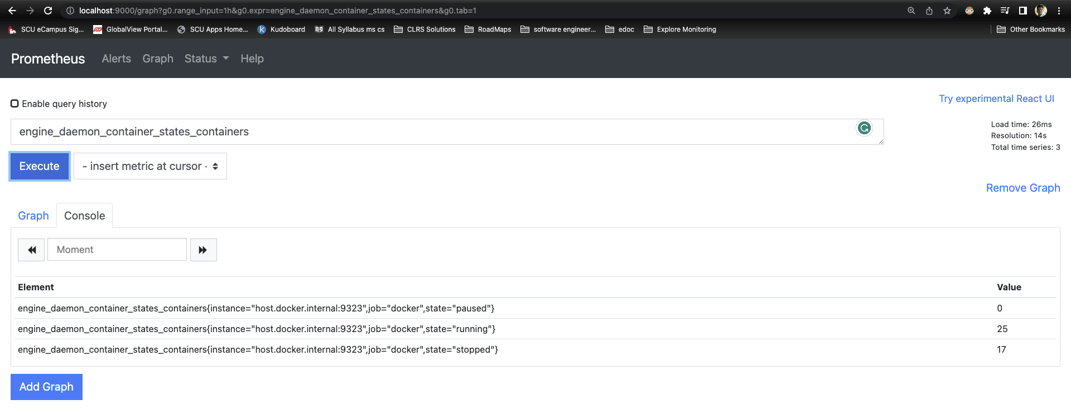
29
Maintenance
Prometheus Integration to search docker metrics.
Notes:
https://pixabay.comzh男子-阅读-触摸屏-博客-数字-片剂-工作-娱乐休闲-屏幕-791049

Slide 30
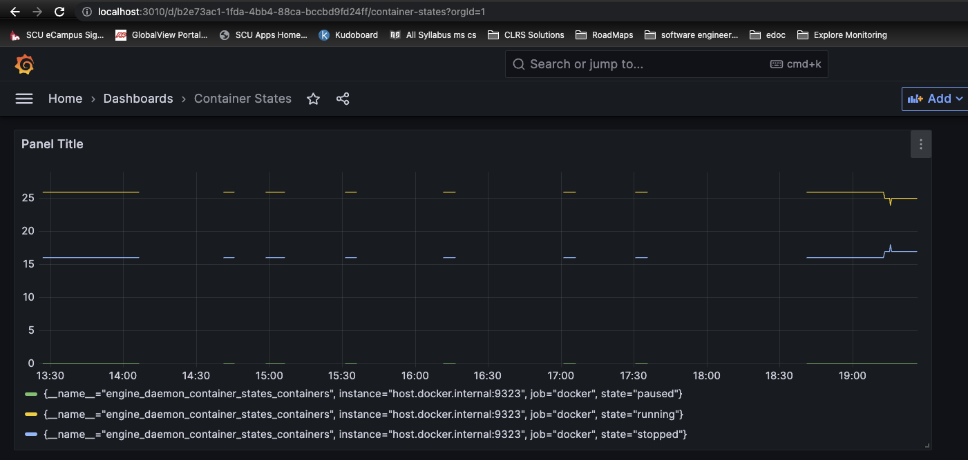
Maintenance
30
Grafana dashboards to visualize ingested docker metrics.
Notes:
https://pixabay.comzh男子-阅读-触摸屏-博客-数字-片剂-工作-娱乐休闲-屏幕-791049

Slide 31
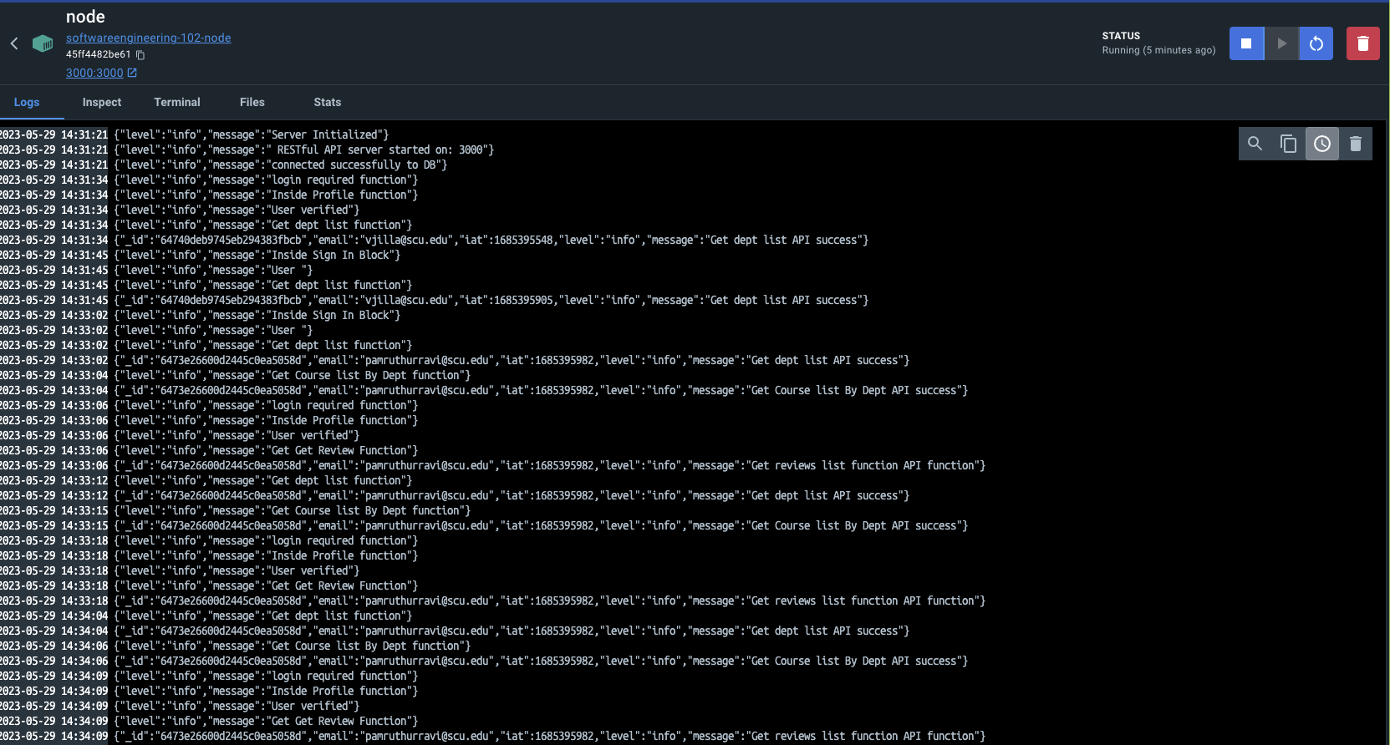
Maintenance Logging
31
Notes:
https://pixabay.comzh男子-阅读-触摸屏-博客-数字-片剂-工作-娱乐休闲-屏幕-791049

Slide 32
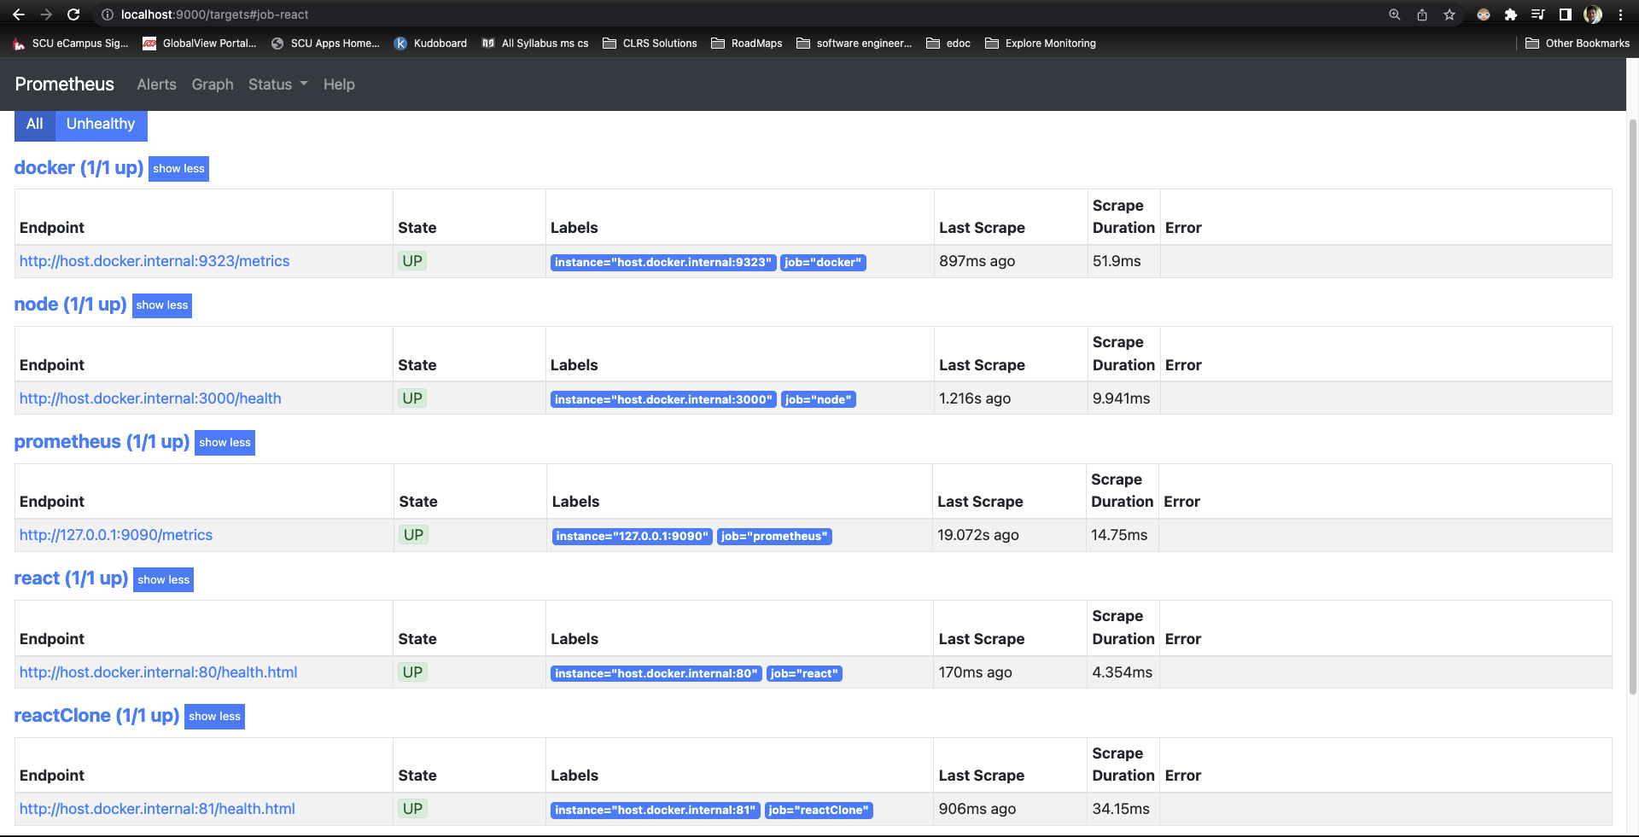
32
Maintenance
Prometheus tracking health URL’s.
Notes:
https://pixabay.comzh男子-阅读-触摸屏-博客-数字-片剂-工作-娱乐休闲-屏幕-791049

Slide 33
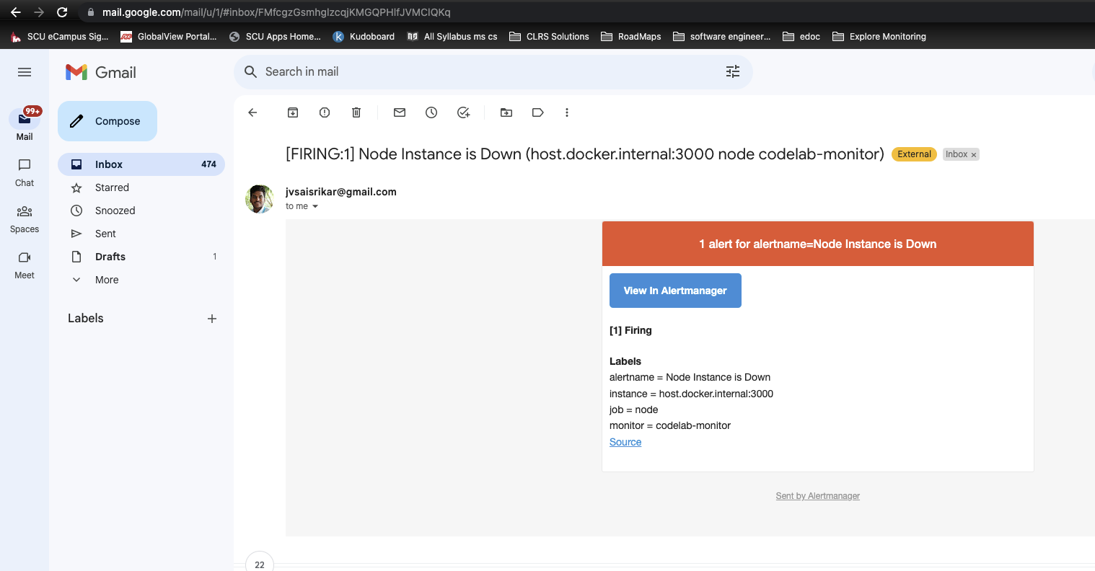
33
Maintenance
Prometheus alerts integration to notify developer when service is down.
Notes:
https://pixabay.comzh男子-阅读-触摸屏-博客-数字-片剂-工作-娱乐休闲-屏幕-791049

Slide 34
34
Risk Assessment
Risk we find
46% Code Coverage
46%
Code
Coverage
Lacking Logging on Frontend and Reporting of failures within frontend
Missing security assessment and audit on the application’s security and practices
Open Issues
The user with a review already posted still sees Add Review button instead of Edit Review button.
Kubernetes Network Connectivity Issues
Need Forgot Password logic

Slide 35
35
Future Enhancement
Advanced Search and Advanced Filtering System
Filter by time slot of the classes and availability of courses by quarters
Implement search by property feature
Discussion Forums
Students can ask questions and get responses on discussion forums while staying anonymous.
Add documentation of APIs and development
Adding admin role to add and manage courses and departments content from web application.

Slide 36
36
Part
Demo
Repository Link: https://github.com/Phaneendra97/SoftwareEngineering-102/tree/v1.1

Slide 37
PPT by
Bowen C
THANKS

